Slide 1
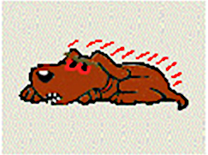
Supporting Affect & Engagement
EDUC 5100: Adaptive Learning Systems
Guest Lecture by Jaclyn Ocumpaugh

Slide 2
Warm-up Activity
What has made you feel competent/incompetent?
When have you felt most incapable of doing something?
What has helped you when you struggle?
Who have you found most supportive?
What have you done when you couldn’t find someone supportive?

Slide 3
Who am I?
Jaclyn Ocumpaugh
Associate Director, Penn Center for Learning Analytics
10 years of research on Affective Computing in the Learning Sciences (including co-development of BROMP method)
Before that, PhD in Sociolinguistics—understanding what social and demographic factors (vs. language internal factors related to production and perception) motivate sound changes (a type of implicit learning)

Slide 4
Core Readings
(DeFalco et al., 2018) = DeFalco, J.A., Rowe, J.P., Paquette, L., Georgoulas-Sherry, V., Brawner, K., Mott, B.W., Baker, R.S., Lester, J.C. (2018) Detecting and Addressing Frustration in a Serious Game for Military Training. International Journal of Artificial Intelligence and Education, 28 (2), 152-193.
(Arroyo et al, 2011) = Arroyo, I., Woolf, B. P., Cooper, D. G., Burleson, W., & Muldner, K. (2011). The impact of animated pedagogical agents on girls' and boys' emotions, attitudes, behaviors and learning. In 2011 IEEE 11th International Conference on Advanced Learning Technologies (pp. 506-510). IEEE.
Secondary Readings
(D’Mello et al., 2010) = D’Mello, S., Lehman, B., Sullins, J., Daigle, R., Combs, R., Vogt, K., ... & Graesser, A. (2010). A time for emoting: When affect-sensitivity is and isn’t effective at promoting deep learning. In International conference on intelligent tutoring systems (pp. 245-254). Springer, Berlin, Heidelberg.
(Arroyo et al., 2007) = Arroyo, I., Ferguson, K., Johns, J., Dragon, T., Meheranian, H., Fisher, D., ... & Woolf, B. P. (2007). Repairing disengagement with non-invasive interventions. In AIED (Vol. 2007, pp. 195- 202).
(Baker et al., 2006) = Baker, R.S.J.d., Corbett, A.T., Koedinger, K.R., Evenson, S.E., Roll, I., Wagner, A.Z., Naim, M., Raspat, J., Baker, D.J., Beck, J. (2006) Adapting to When Students Game an Intelligent Tutoring System. Proceedings of the 8th International Conference on Intelligent Tutoring Systems, 392- 401.
(Rajendran et al., 2018) = Rajendran, R., Iyer, S., & Murthy, S. (2018). Personalized affective feedback to address students’ frustration in ITS. IEEE Transactions on Learning Technologies, 12(1), 87-97.
(D’Mello et al., 2014) = D’Mello, S., Lehman, B., Pekrun, R., & Graesser, A. (2014). Confusion can be beneficial for learning. Learning and Instruction, 29, 153-170.
(Mendez et al., 2005) = Mendez, G. R., du Boulay, B., & Luckin, R. (2005). Be bold and take a challenge”: Could motivational strategies improve help-seeking. In Proceedings of the 2005 conference on Artificial Intelligence in Education: Supporting Learning through Intelligent and Socially Informed Technology (pp. 459-466).

Slide 5
More warm-ups
What kinds of engagement and disengagement did you read about?
What kinds of interventions did you read about?

Slide 6
Theoretical Background
Control Value Theory
Self Efficacy Theory
Social Identity Theory
Ansel’s Frustration Theory
Growth Mindset
Expectancy Value
Affect Dynamics
Any others?

Slide 7
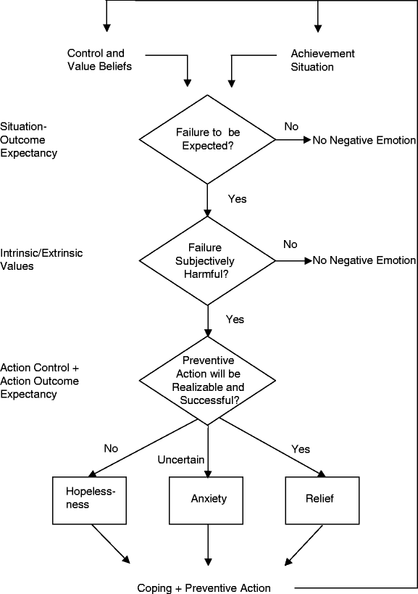
Control-Value Theory
Pekrun, R. (2006). The control-value theory of achievement emotions: Assumptions, corollaries, and implications for educational research and practice. Educational psychology review, 18(4), 315-341.

Slide 8
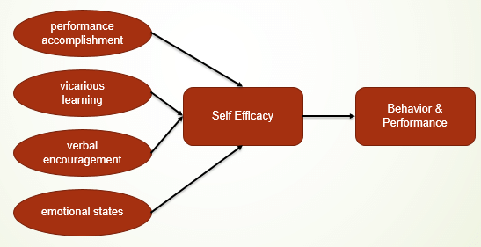
Bandura’s Self-Efficacy Theory
Razzaq, Abdur & Samiha, Yulia & Anshari, Muhammad. (2018). Smartphone Habits and Behaviors in Supporting Students Self-Efficacy. International Journal of Emerging Technologies in Learning (iJET). 13. 94. 10.3991/ijet.v13i02.7685.

Slide 9
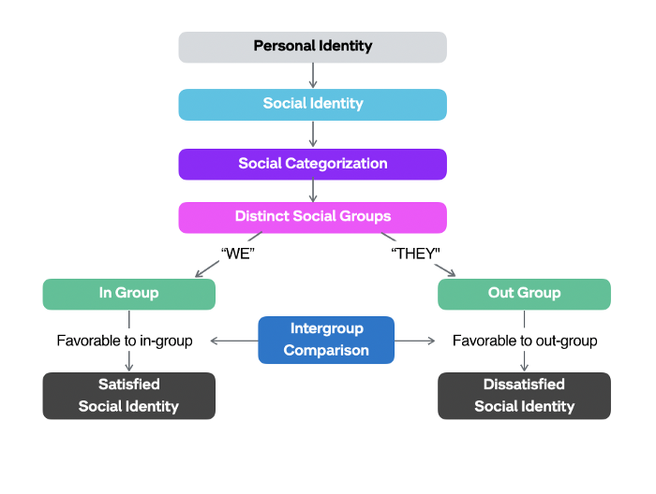
Tajfel & Turner’s Identity Theory
Interpretated by: https://jenbonhomme.medium.com/social-identity-theory-5307b0d57413
Example msg: “Every single man in this Army plays a vital role,” said General Patton. “Don’t ever let up. Every man has a job to do and he must do it!”

Slide 10
Amsel’s Frustration Theory (very tl;dr)
Rewarding students who push through frustration >>>>> avoiding the frustration
We don’t want our doctors or teachers or lawyers to avoid situations that are frustrating to them; we want them to be able to self-regulated that behavior and move forward.
Related to studies of approach vs. avoidance in anxiety treatment and research

Slide 11
Whitmer et al.’s “Presence”
Presence is defined as the subjective experience of being in one place or environment, even when one is physically situated in another.
...presence refers to experiencing the computer-generated environment rather than the actual physical locale.

Slide 12
Duckworth’s Grit
Passion + Perseverence

Slide 13
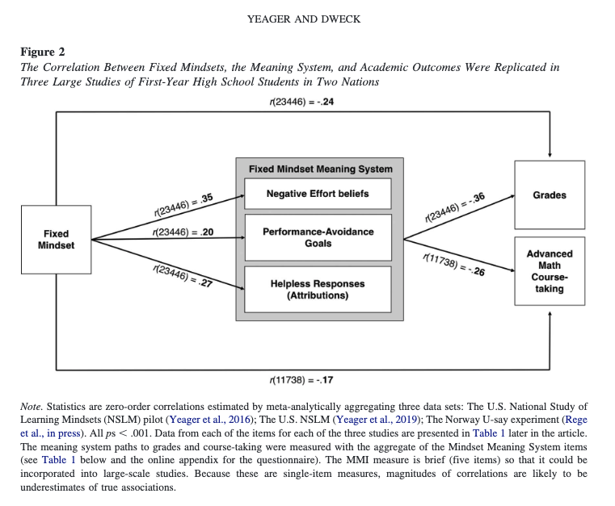

Slide 14
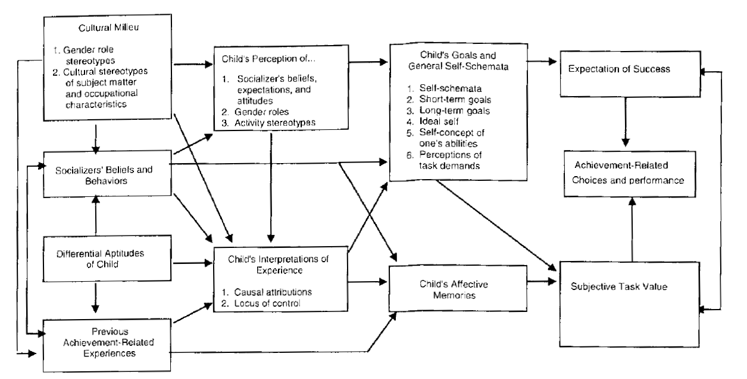
Expectancy-Value Theory

Slide 15
D’Mello &Graesser H1 Model
Surprise
Novelty
1b
Extreme
Novelty
1c .
Impasse
Detected
3a Failure/Goals
Blocked
4a Persistent Failure/
Hopelessness
1a Impasse Detected
Eng. Conc.
Equilibrium
Confusion
Disequilibrium
Frustration
Stuck
Boredom
Disengaged
2c
Impasse
Resolved
2a Impasse Resolved
2b .
Impasse Resolved
& Goal Attained
Delight
Achievement

Slide 16
What kinds of things do you think are important for understanding how to respond to students affective needs?
Traits
States

Slide 17

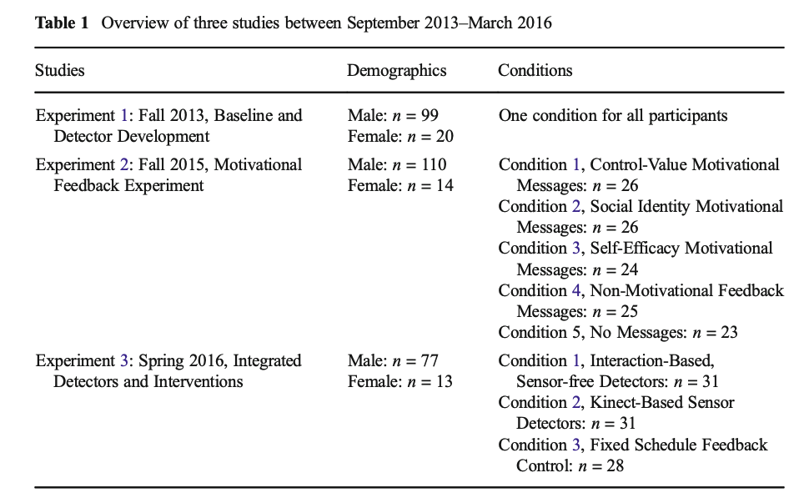
DeFalco, J.A., Rowe, J.P., Paquette, L., Georgoulas-Sherry, V., Brawner, K., Mott, B.W., Baker, R.S., Lester, J.C. (2018) Detecting and Addressing Frustration in a Serious Game for Military Training. International Journal of Artificial Intelligence and Education, 28 (2), 152-193.

Slide 18
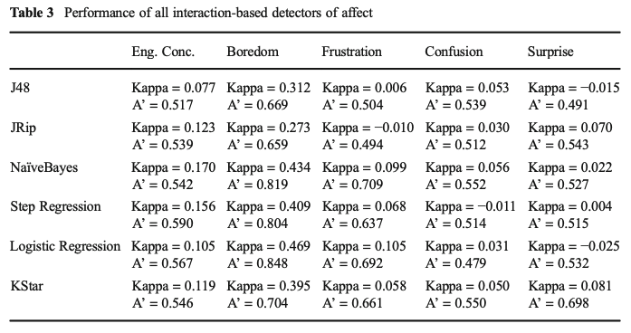
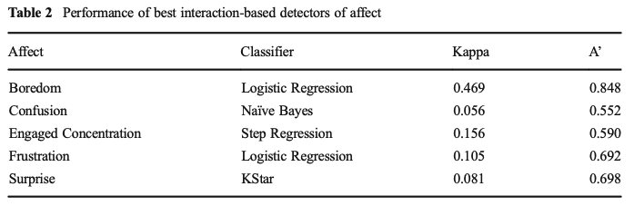
Note: Kappa scales from -1 to 1, 0=chance A’ scales from 0 to 1, .5=chance
Notes:
“Cohen's kappa and A′ differ in important ways, but both use very similar scales. Cohen's kappa assesses the degree to which the detector is better than chance at identifying which clips involve a specific affective state. A kappa of 0 indicates that the detector performs at chance, and a kappa of 1 indicates that the detector performs perfectly. For example, a kappa of 0.358 would indicate that a detector of boredom is 35.8% better than chance at determining which clips in a large sample included instances of boredom. A′ is the probability that the detector will correctly identify whether a specific affective state is present or absent in a specific clip. A′ is equivalent to W, the Wilcoxon statistic, and closely approximates the area under the receiver operating curve (Hanley & McNeil, 1982). A model with an A′ of 0.5 performs at chance, and a model with an A′ of 1.0 performs perfectly. For example, an A′ of 0.65 would indicate that a detector of boredom can distinguish a bored student from a non-bored student 65% of the time. A′ takes detector confidence into account when doing this; eg, if the model thought a bored student had a 62% probability of being bored, while a non-bored student had a 61% probability of being bored, it would give credit to the model for seeing that the bored student had a higher probability of being bored than the non-bored student. In other words, Cohen's kappa assesses a model's final decisions (and is therefore a better assessment of how well the model will perform when used to drive interventions), while A′ assesses a model's confidence in its decisions (and is therefore a better assessment of how well the model will perform when used in discovery with models analyses, which typically take confidence into account).” Ocumpaugh et al., 2014

Slide 19
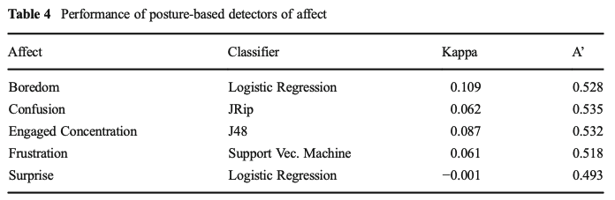
Note: Kappa scales from -1 to 1, 0=chance A’ scales from 0 to 1, .5=chance

Slide 20
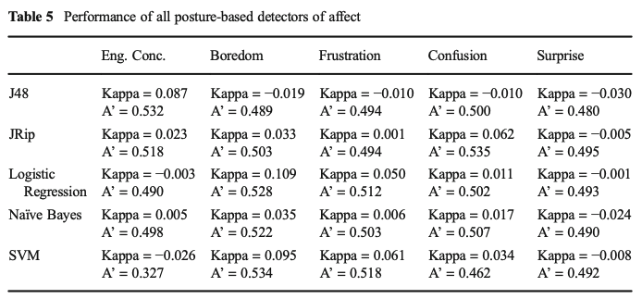
Note: Kappa scales from -1 to 1, 0=chance A’ scales from 0 to 1, .5=chance

Slide 21
Note: Kappa scales from -1 to 1, 0=chance A’ scales from 0 to 1, .5=chance

Slide 22
DeFalco, J.A., Rowe, J.P., Paquette, L., Georgoulas-Sherry, V., Brawner, K., Mott, B.W., Baker, R.S., Lester, J.C. (2018) Detecting and Addressing Frustration in a Serious Game for Military Training. International Journal of Artificial Intelligence and Education, 28 (2), 152-193.

Slide 23
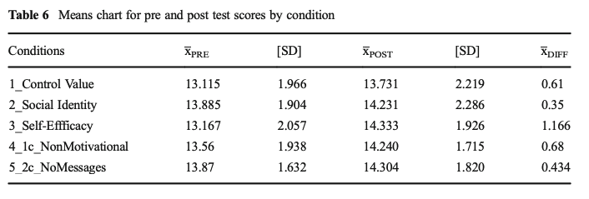
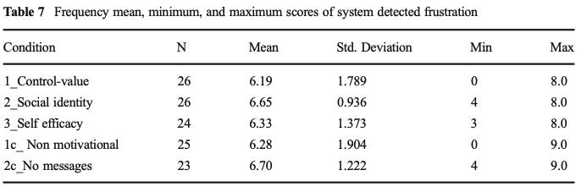
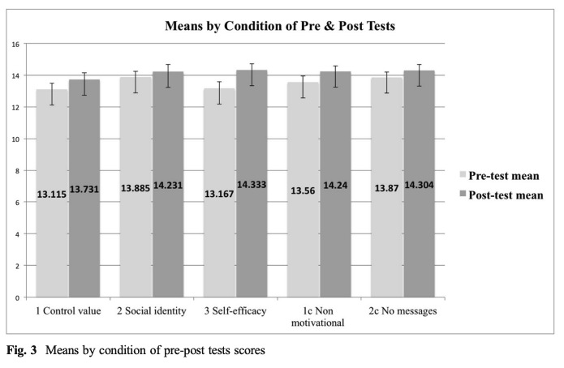
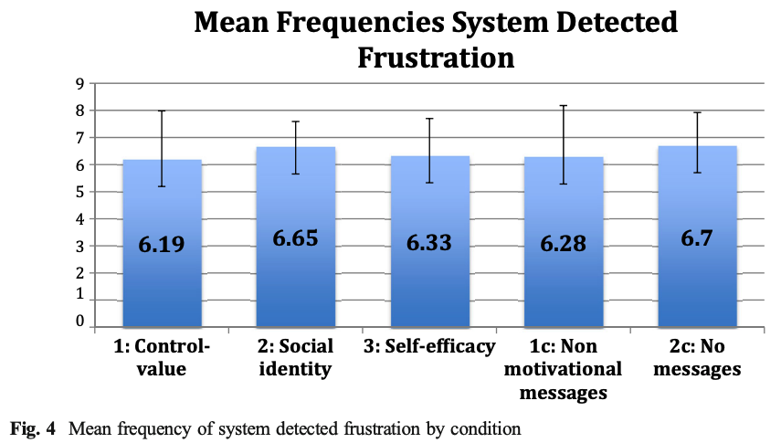
Conditions did not differ by pre, post or frustration levels

Slide 24
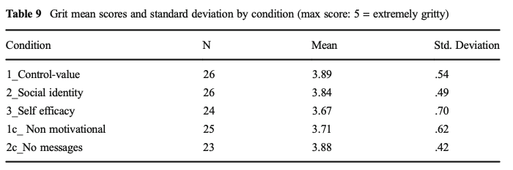
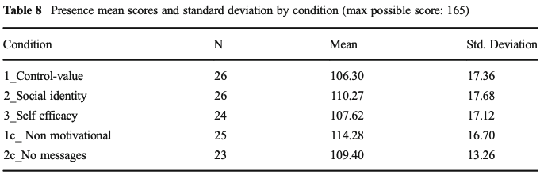
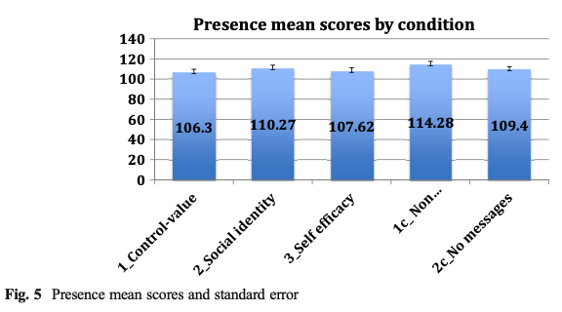
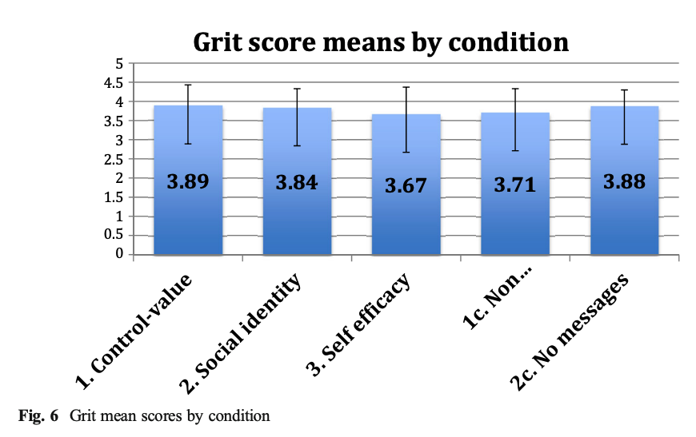
Conditions did not differ by presence or grit survey results

Slide 25
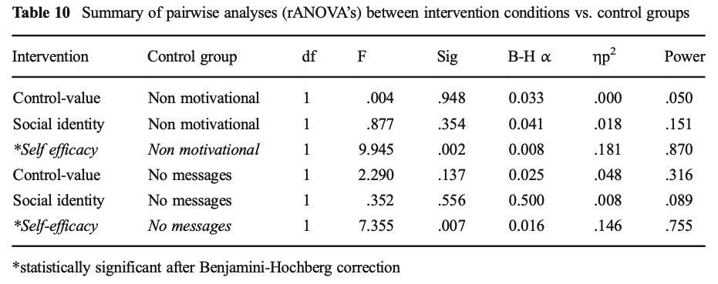
Overall, the self-efficacy interventions worked best

Slide 26
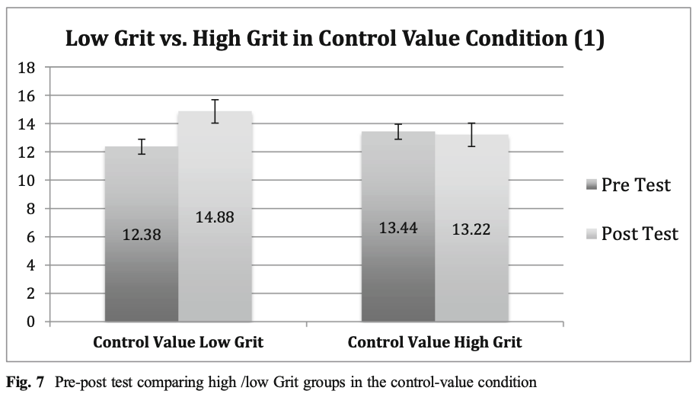
Why were Control-Value mgs only effective for low-grit students?

Slide 27
DeFalco, J.A., Rowe, J.P., Paquette, L., Georgoulas-Sherry, V., Brawner, K., Mott, B.W., Baker, R.S., Lester, J.C. (2018) Detecting and Addressing Frustration in a Serious Game for Military Training. International Journal of Artificial Intelligence and Education, 28 (2), 152-193.

Slide 28
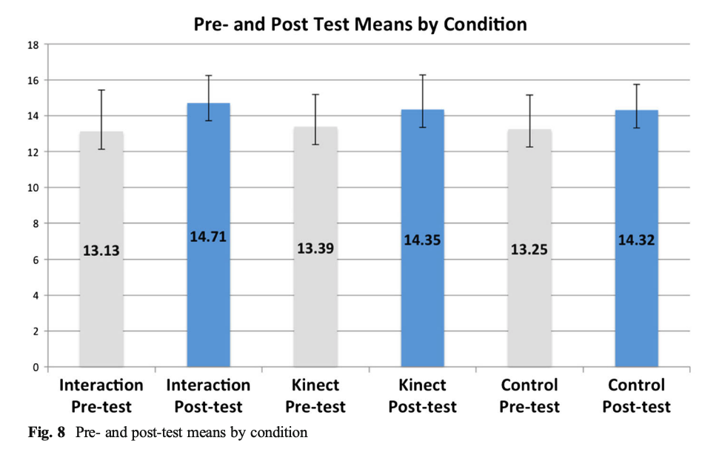
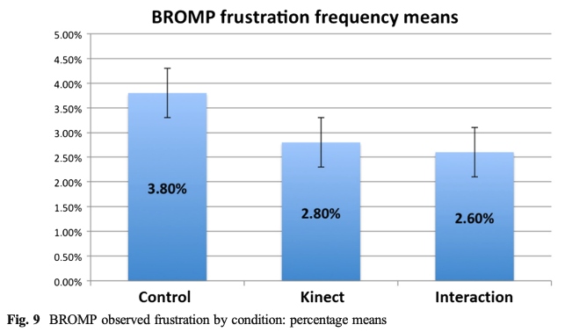
Differences in pre, post, and frustration-levels by condition
There were positive learning gains across all three conditions (see Fig. 8), but there was no significant difference in learning gains by condition, F(2, 86) = .534, p = .588, ηp2 = .012.

Slide 29
Differences in pre, post, and frustration-levels by condition
There were positive learning gains across all three conditions (see Fig. 8), but there was no significant difference in learning gains by condition, F(2, 86) = .534, p = .588, ηp2 = .012.

Slide 30
Differences in pre, post, and frustration-levels by condition
There were positive learning gains across all three conditions (see Fig. 8), but there was no significant difference in learning gains by condition, F(2, 86) = .534, p = .588, ηp2 = .012.

Slide 31
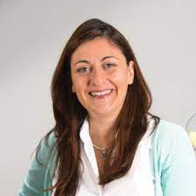
Arroyo, I., Woolf, B. P., Cooper, D. G., Burleson, W., & Muldner, K. (2011). The impact of animated pedagogical agents on girls' and boys' emotions, attitudes, behaviors and learning. In 2011q IEEE 11th International Conference on Advanced Learning Technologies (pp. 506-510). IEEE.

Slide 32
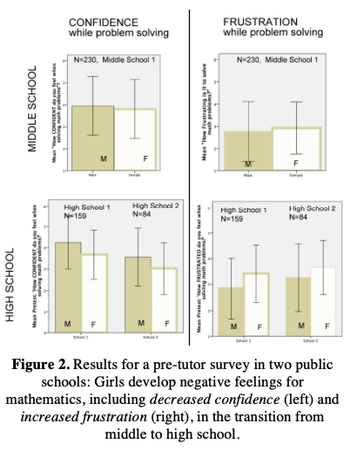

Slide 33
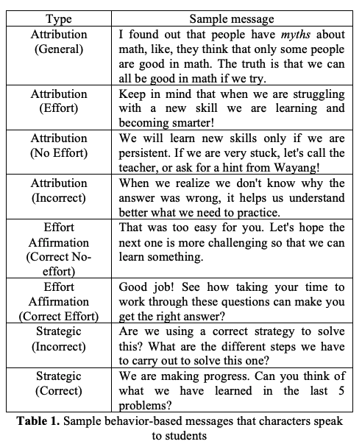

Slide 34
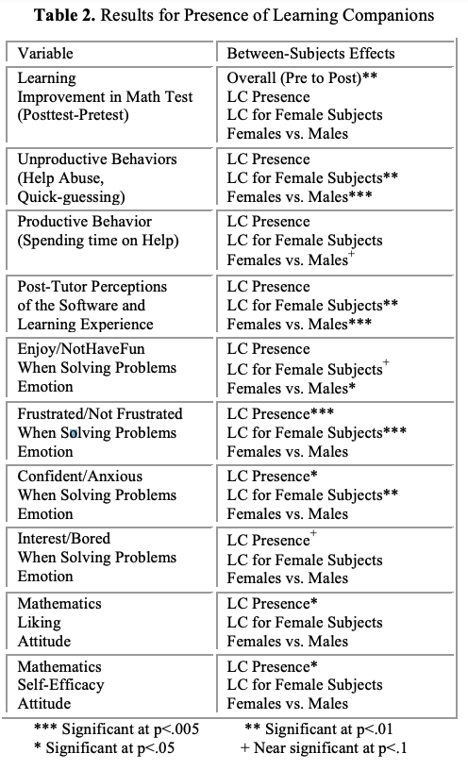
Let’s talk about the outcome variables:
Are they states or traits?
Which ones moved the most?

Slide 35
Let’s talk about the outcome variables:
Are they states or traits?
Which ones moved the most?
Variable | LC | LC-Fem | F vs. M
Learning (post-pre), overall significant
Unproductive Behaviors |  | ** | **
Productive Behaviors |  |  | +
Students Perceptions of the Software |  | ** | ***
Enjoyment/not during problem solving |  | + | *
Frustration/not during problem solving | *** | ***
Confidence/Anxiousness during problem solving | * | **
Interest/Boredom during problem solving | +
Math Liking Survey | *
Math Linking Self-Efficacy | *

Slide 36
Questions
What would these results mean for future research?
How might we operationalize things differently?
Which things seem hardest to move, based on these results? Or compared to other studies that you have read?
We saw gender effects in some of these studies. What other population differences might we expect? Do you think military cadets and middle schoolers might experience affect differently? Process it differently?

Slide 37
